Slide 1

PROGRAMMING WITH ARDUINO

Slide 2
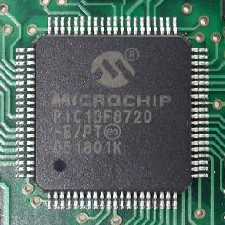
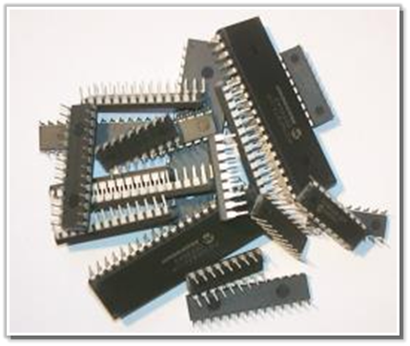
Micro-Controller:
It is a micro-computer. As any computer it has internal CPU, RAM, IOs interface.
It is used for control purposes, and for data analysis.
Famous microcontroller manufacturers are MicroChip, Atmel, Intel, Analog devices, and more.
[list]

Slide 3

Arduino
A microcontroller board, contains on-board power supply, USB port to communicate with PC, and an Atmel microcontroller chip.
It simplifies the process of creating any control system by providing the standard board that can be programmed and connected to the system without the need to any sophisticated PCB (Printed Circuit Board) design and implementation.
It is an open source hardware, any one can get the details of its design and modify it or make his own one himself.
Notes:
Atmega328p

Slide 4
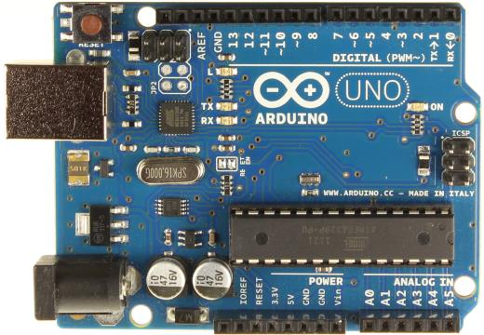
Arduino UNO:
Digital output
~: PWM.
0,1: Serial port.
In circuit Serial programming
Atmel MicroController
USB port
Power input
Analog input.
Power Supply

Slide 5
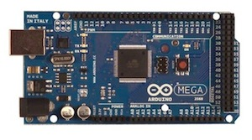
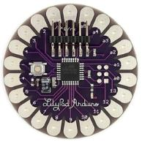
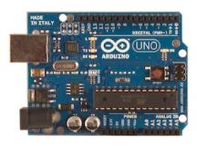
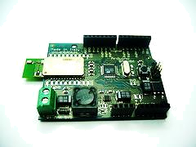
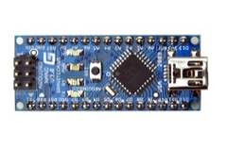
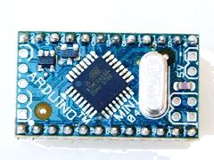
Arduino boards
UNO
Mega
LilyPad
Arduino BT
Arduino Nano
Arduino Mini

Slide 6
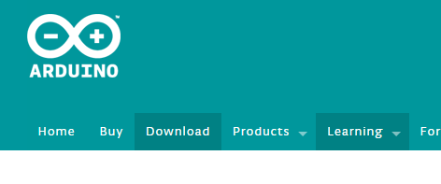
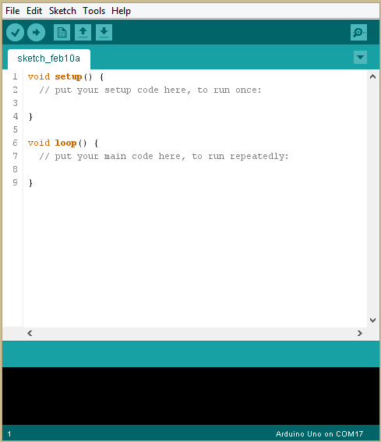
Arduino IDE:
You can download the Arduino IDE (The program used to write code and uploading it to arduino boards) from:
http://arduino.cc/en/Main/Software

Slide 7
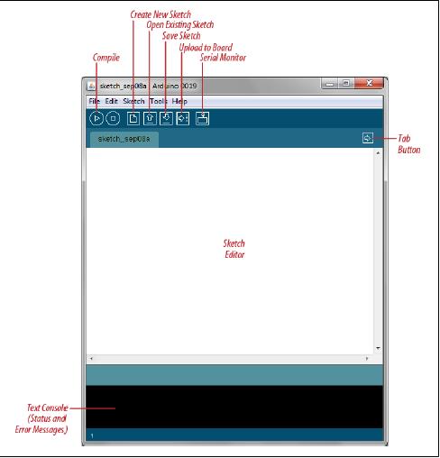
Arduino IDE

Slide 8
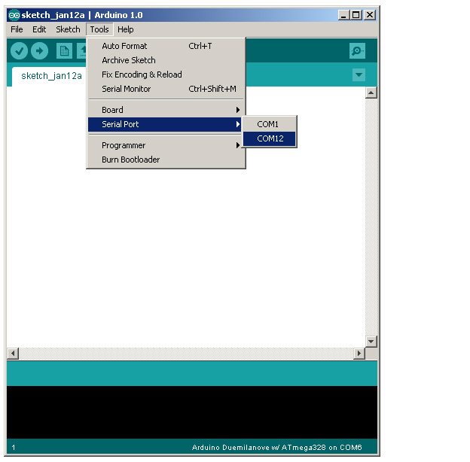
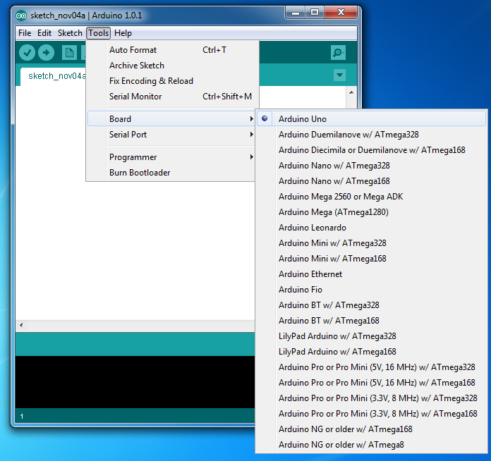
Select Serial Port and Board

Slide 9
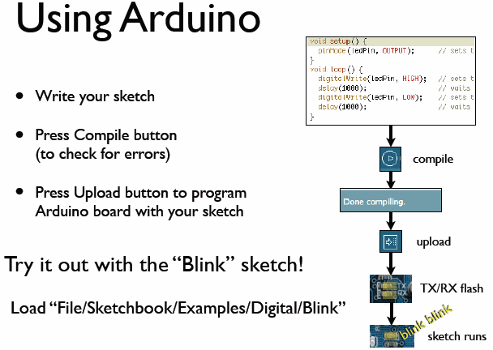
todbot.com/blog/bionicarduino

Slide 10
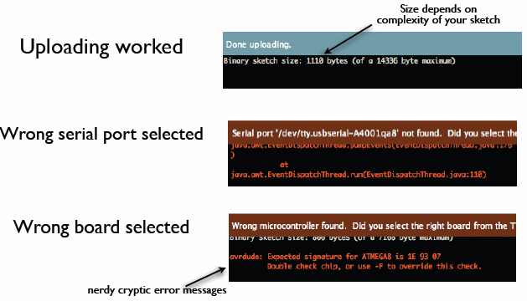
Status Messages
todbot.com/blog/bionicarduino

Slide 11
Code Strucuture
void setup()
{
Used to indicate the initial values of system on starting.
}
void loop()
{
Contains the statements that will run whenever the system is powered after setup.
}

Slide 12
Constant
Defining Pin Levels: HIGH or LOW
  When reading or writing to a digital pin there are only two possible values a pin can take/be-set-to: HIGH LOW.
Defining Digital Pins modes: INPUT or OUTPUT
  Digital pins can be used as INPUT, or OUTPUT. Changing a pin with pinMode() changes the electrical behavior of the pin

Slide 13
Functions
Digital IO
  pinMode(pin, mode);
    Configures a digital pin to read (input) or write (output) a digital value
  digitalRead(pin);
    Reads a digital value (HIGH or LOW) on a pin set for input
  digitalWrite(pin, value);
    Writes the digital value (HIGH or LOW) to a pin set for output
Analog IO
  analogRead(pin) – 10 bits available(Arduino Uno)
    Reads the value from the specified analog pin
  analogWrite(pin, value)–8 bits available(Arduino Uno)
    Writes an analog value (PWM) to the pin

Slide 14
Functions
Time
  delay(ms)
    Pauses the program for the specified milliseconds
    1 second = 1000 milliseconds
Serial (Communication)
  begin(speed)
    Sets the serial communication at particular baud rate
  available()
    Checks if data is available in serial
  read() and write(val), write(str), write(buf,len)
    Send and receive data using serial communication
  print(data)
    Prints the data in human readable format (for debug)

Slide 15
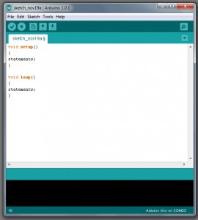
A Little Bit About Programming
Code is case sensitive
Statements are commands and must end with a semi-colon
Comments follow a // or begin with /* and end with */
loop and setup

Slide 16
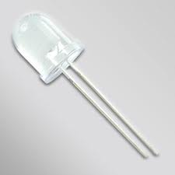
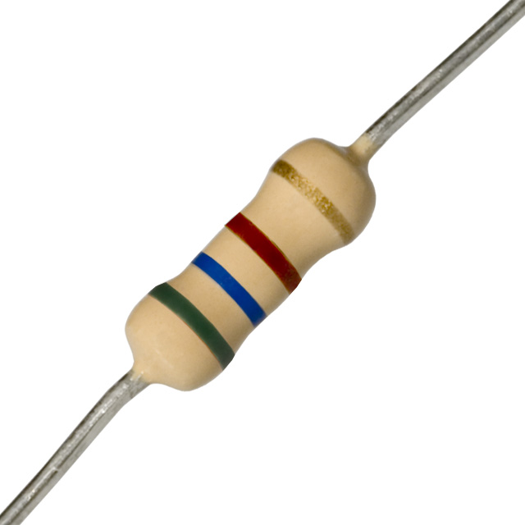
Lesson #1 – Blinking LED
What will you need? Arduino, breadboard, 4 wires, 10mm LED(large white), 560Ω resistor, USB cable.
Longer Lead is POSITIVE

Slide 17
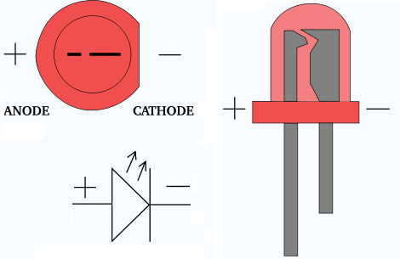
LEDs
An LED (light emitting diode) emits light when a small current passes through it. You can identify it as it looks like a small bulb
It only works in ONE direction. So make sure you attach it correctly. Also it often needs a resistor to limit the current going to it.
Schematic symbol

Slide 18
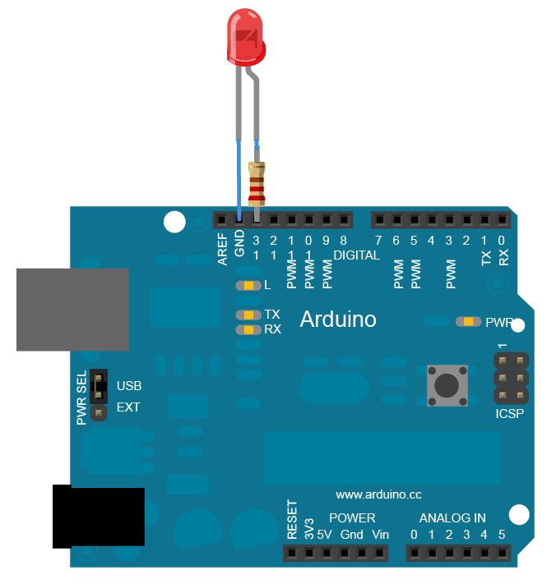
Digital Write-LED Blink

Slide 19
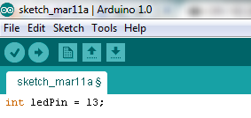
Writing the code - Integers
Load up the Arduino software.
Begin by using the variable “int” or integer and let’s tell the Arduino which port the LED is in.

Slide 20

Writing the code - Setup
Remember that SETUP is used for things that only need to be done once. Therefore we must tell the Arduino that the LED in port 13 is an output..

Slide 21
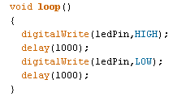
Writing the code - Loop
The next steps is telling the Arduino what we want to do with the LED. We first need to use the digitalWrite command to turn the LED ON. We then use the “delay” command to specify and amount of time in milliseconds. We then use the same command to turn it OFF then wait again. Since this is a loop the process will repeat forever until the power is removed.

Slide 22
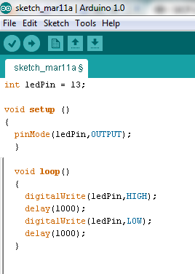
Compile
To compile your sketch, click the checkmark.
Make sure your Arduino is plugged into an available USB port.
Click the arrow to download the program to Arduino. If everything is attached correctly. The LED should blink.

Slide 23
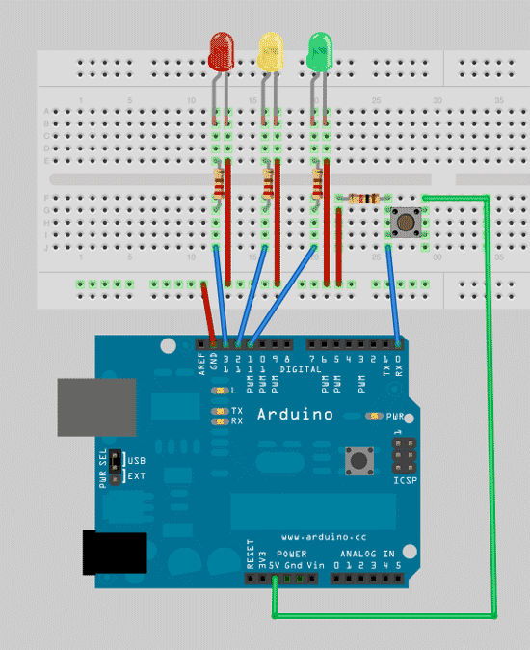
Traffic Light Simulator

Slide 24
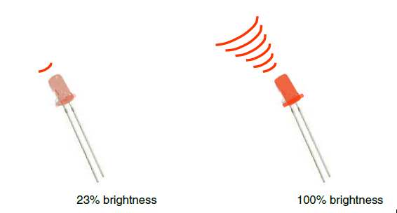
Analog Output
Can a digital devise produce analog output?
Image from Theory and Practice of Tangible User Interfaces at UC Berkley
Analog output can be simulated using pulse width modulation (PWM)

Slide 25
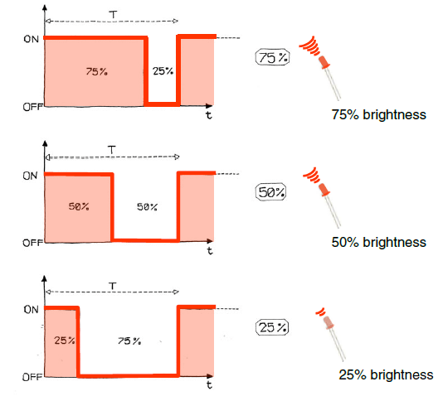
Pulse Width Modulation
Can’t use digital pins to directly supply say 2.5V, but can pulse the output on and off really fast to produce the same effect
The on-off pulsing happens so quickly, the connected output device “sees” the result as a reduction in the voltage
Image from Theory and Practice of Tangible User Interfaces at UC Berkley

Slide 26
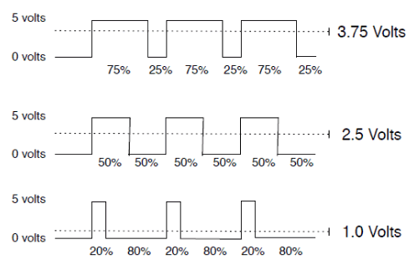
PWM Duty Cycle
output voltage = (on_time / cycle_time) * 5V
Image credit: Tod Kurt
Fixed cycle length; constant number of cycles/sec

Slide 27
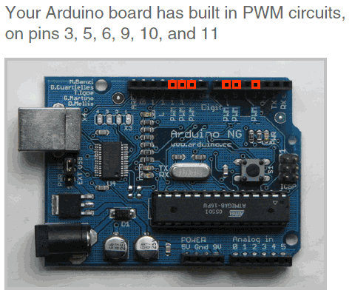
PMW Pins
Command: analogWrite(pin,value)
value is duty cycle: between 0 and 255
Examples:
analogWrite(9, 128)
for a 50% duty cycle
analogWrite(11, 64)
for a 25% duty cycle
Image from Theory and Practice of Tangible User Interfaces at UC Berkley

Slide 28
Controlling the Brightness
Switch the LED pin to #9 (change the integer in the code as well) and then replace with this line in the loop
analogwrite(ledPin,new number)
Where the “new number” can be any value between 0 and 255.

Slide 29
Fading
- Go to FILE, then EXAMPLES, then ANALOG, then FADING.

Slide 30
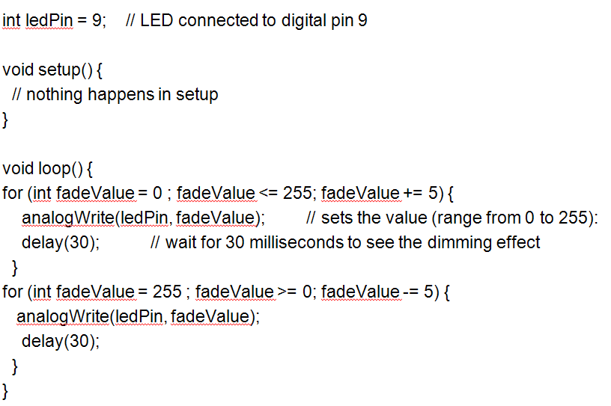
LED Fading

Slide 31
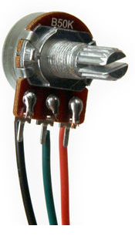
Analog Input
Understanding Potentiometer – a variable resistor

Slide 32
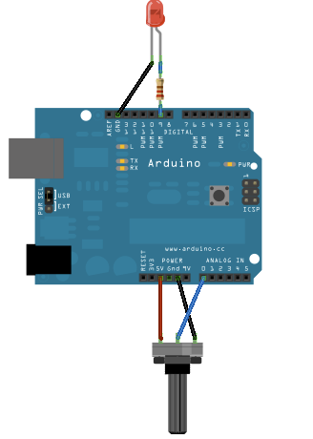
Analog Communication

Slide 33
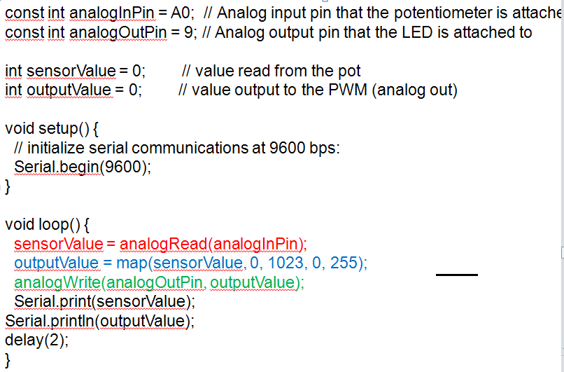
Controlling LED through Potentiometer

Slide 34
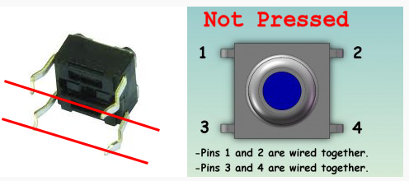
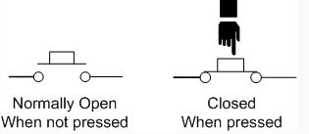
Digital Read
Pushbutton

Slide 35
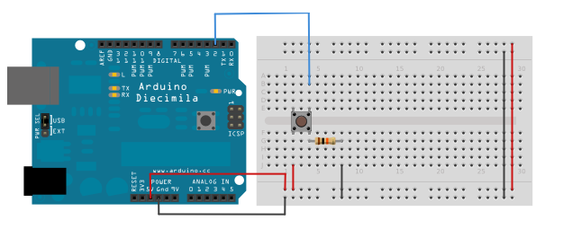
Digital Read
Pushbutton

Slide 36
Digital Read
The pushbutton is a component that connects two points in a circuit when you press it. The example turns on an LED when you press the button.
We connect three wires to the Arduino board. The first goes from one leg of the pushbutton through resistor to the GND. The second goes from the corresponding leg of the pushbutton to +5V. The third connects to a digital i/o pin (here pin 2) which reads the button's state.
When the pushbutton is open (unpressed) there is no connection between the two legs of the pushbutton, so we read LOW.
When the button is closed (pressed), it makes a connection between its two legs, connecting the pin to +5V, so that we read a HIGH.

Slide 37
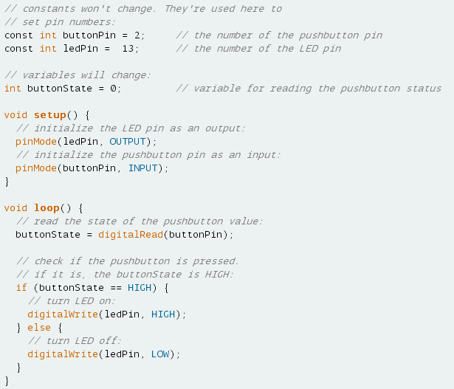
Controlling LED through Pushbutton

Slide 38
Exercise
Count the number of button pushes….

Slide 39
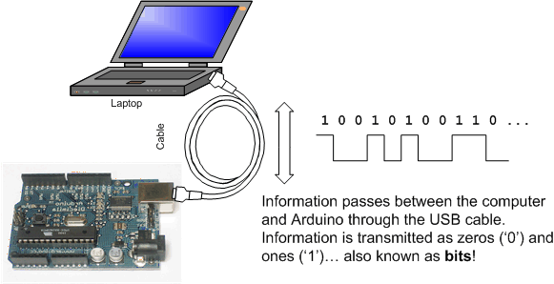
Serial Communication
Image from http://www.ladyada.net/learn/arduino/lesson4.html

Slide 40
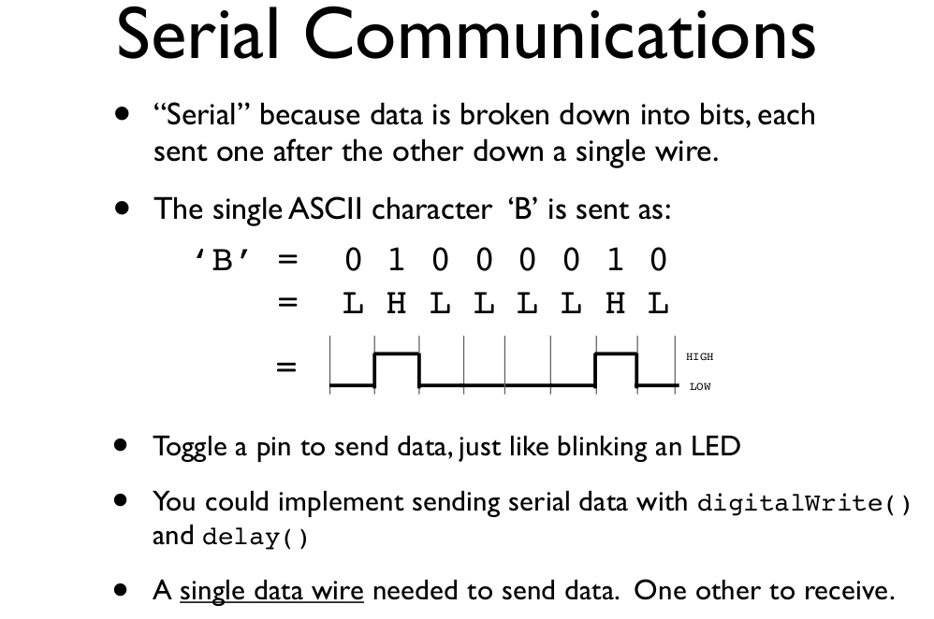
todbot.com/blog/bionicarduino

Slide 41
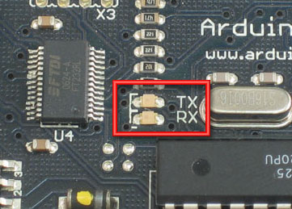
Serial Communication
Compiling turns your program into binary data (ones and zeros)
Uploading sends the bits through USB cable to the Arduino
The two LEDs near the USB connector blink when data is transmitted
  RX blinks when the Arduino is receiving data
  TX blinks when the Arduino is transmitting data
todbot.com/blog/bionicarduino

Slide 42
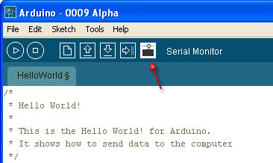
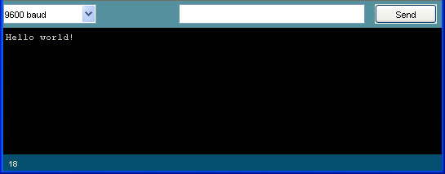
Open the Serial Monitor and Upload the Program

Slide 43
Some Commands
Serial.begin()
- e.g., Serial.begin(9600)
Serial.print() or Serial.println()
- e.g., Serial.print(value)
Serial.read()
Serial.available()
Serial.write()
Serial.parseInt()
Example Program

